Slide 1
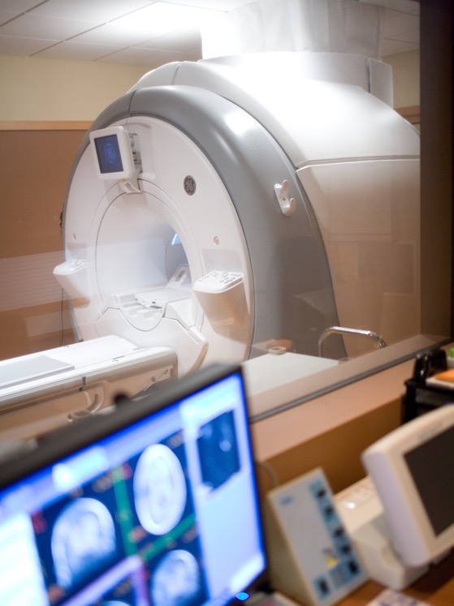
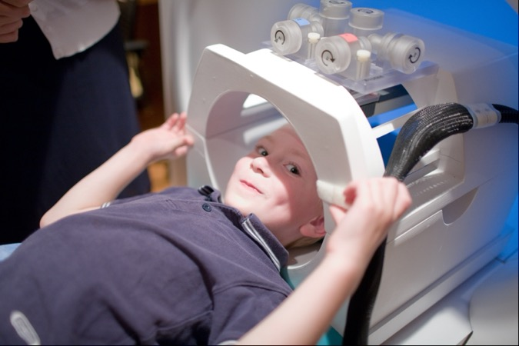
The Lane Neuroimaging Lab at the University of Wisconsin-Madison Presents:
Bucky and Your Research Visit
Updated Sept 15, 2022

Slide 2
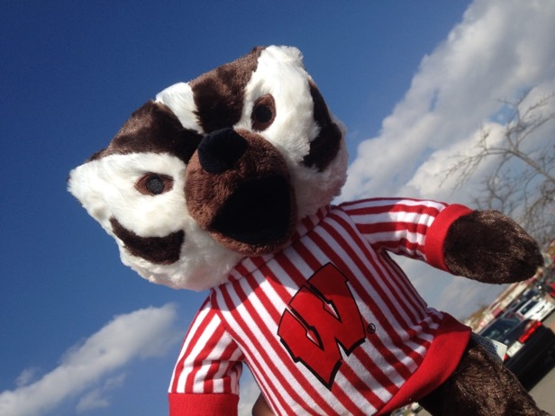
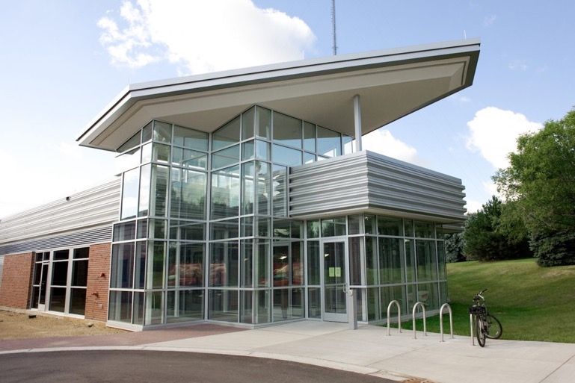
Hello!
I am Bucky the Badger.
Bucky
It sounds like you will be coming to the Lane Neuroimaging Lab at UW HealthEmotions Research Institute to help us with research. We can’t wait to see you!
UW HealthEmotions Research Institute

Slide 3
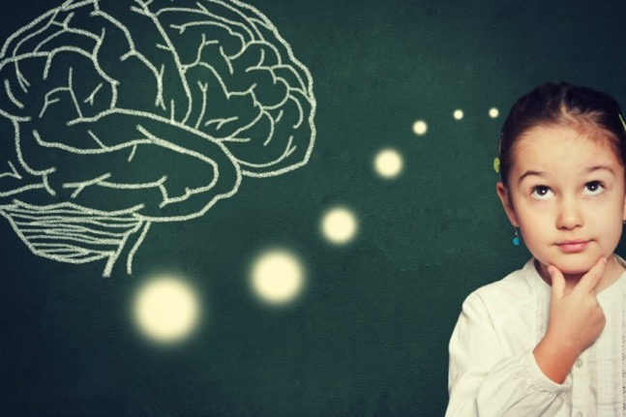
This research is looking at the brain and actions of lots of different children.
We hope to use this information to help kids.

Slide 4

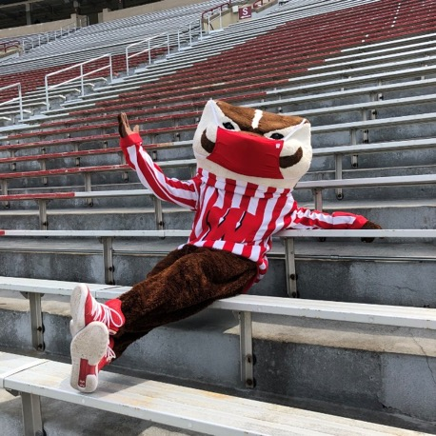
Just a friendly reminder: during this study, we’ll all be wearing our facemasks!
This will help keep us safe and from spreading germs.

Slide 5
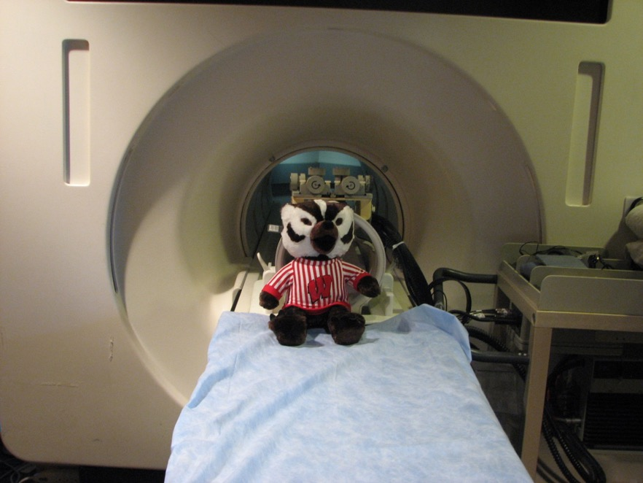
Now, I am going to show you what to expect when you come to visit us for your MRI scan.
I like to help people learn about what it is like to get MRI brain pictures taken.

Slide 6
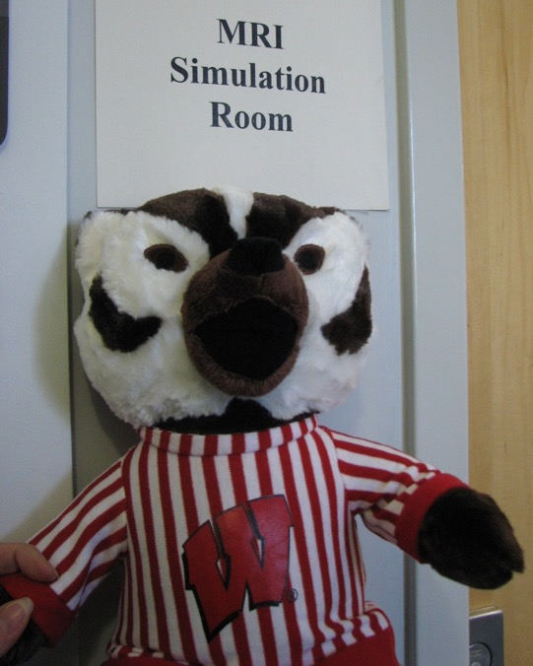
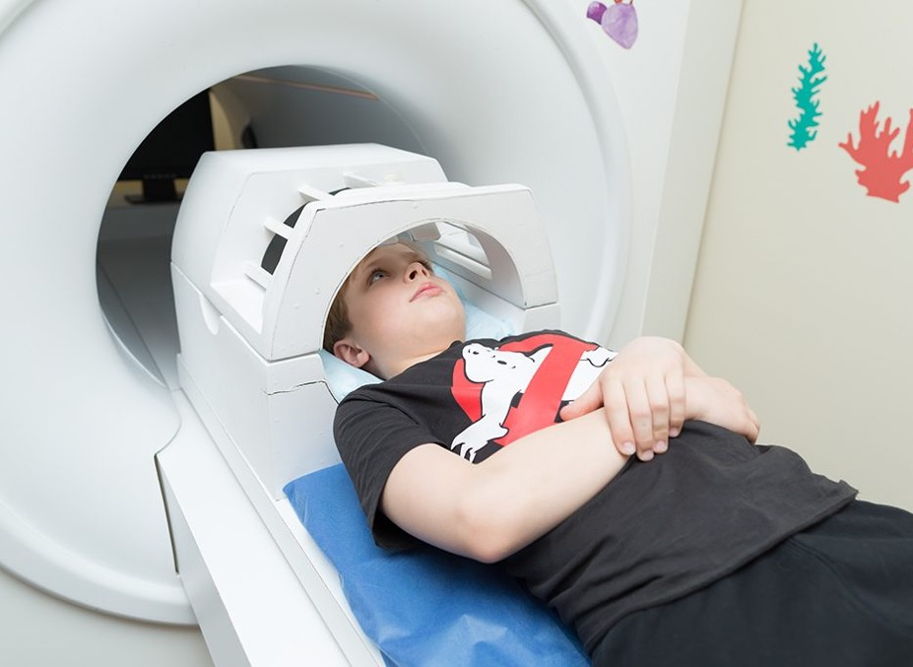
Before we get started, you will get to practice taking brain pictures.
This is a great time to answer any questions you might have and to practice the statue game!

Slide 7








You Can Pick a Fun Movie to Watch in the MRI
Frozen
Finding Nemo
Ice Age: Continental Drift
Monsters, INC.
Cars
Rise of the Guardians
Wreck-It Ralph
Blue Planet
www.imdb.com

Slide 8

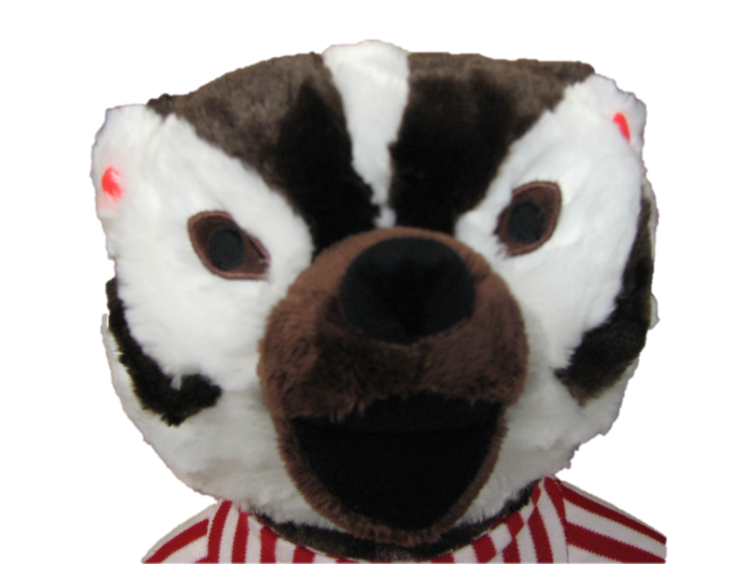
The MRI brain camera makes loud noises. We will ask you to wear ear plugs. They fit right into your ear.
See Bucky wearing his ear plugs?

Slide 9
What does the camera that takes the brain pictures sound like?

Slide 10

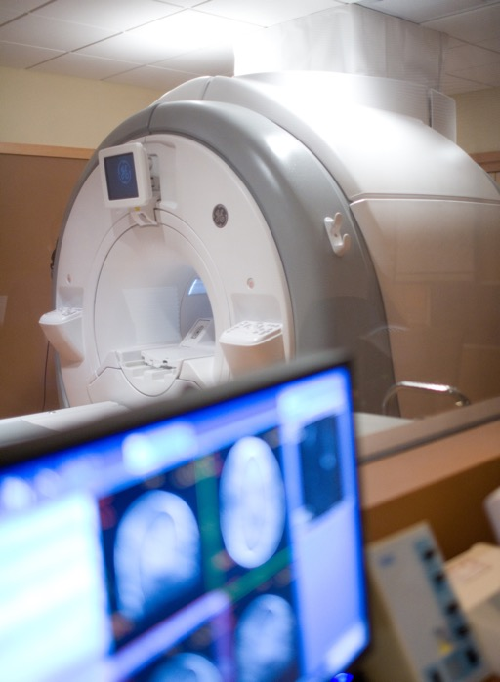


Some cameras go “click” when they take pictures. Other cameras go “snap.”
MRI Brain “Camera”
Our MRI brain camera makes its own special noises. These noises are louder than a regular camera and sound sort of like drums being played. You will have ear plugs.

Slide 11
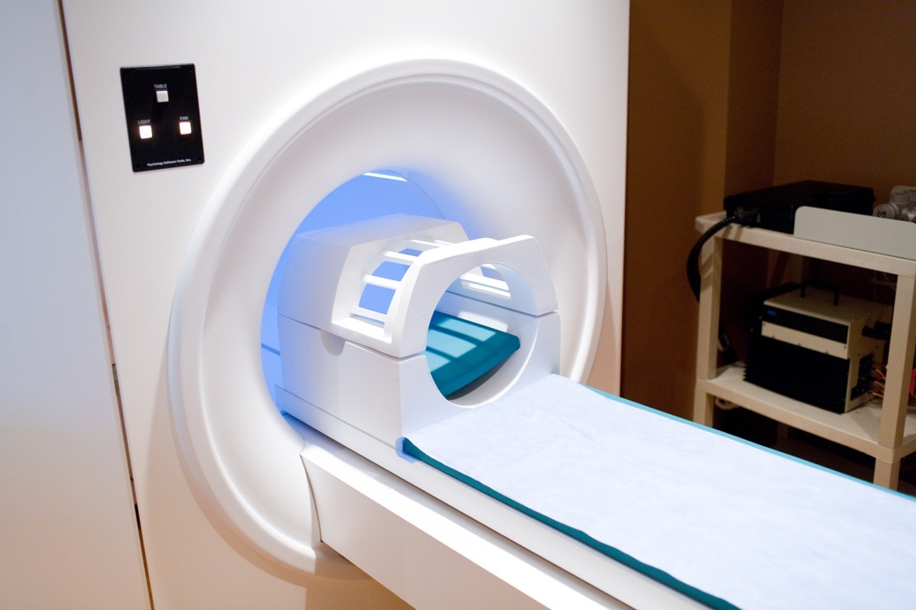
What does the camera that takes the brain pictures look like?

Slide 12

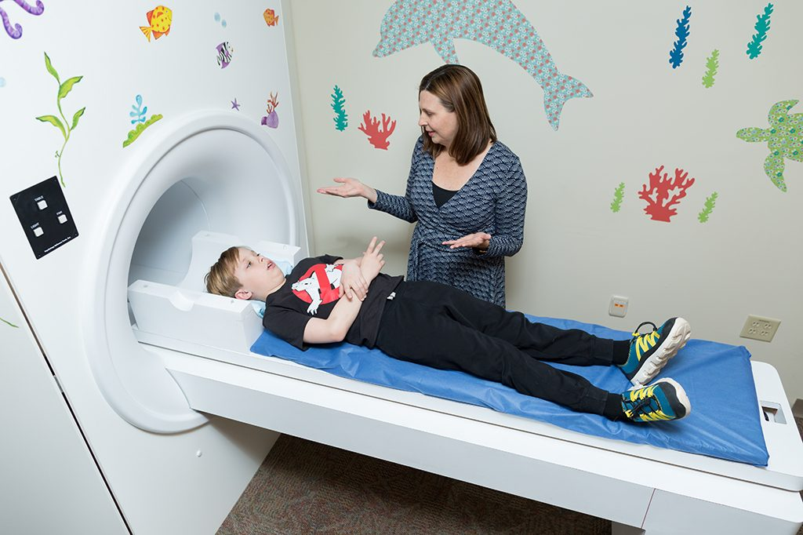
The MRI brain pictures are sort of like when people take pictures of you with a regular camera.
Regular Camera
MRI Brain “Camera”
The main difference is that the MRI camera is so big that you get to lie down in it, like a bed.

Slide 13
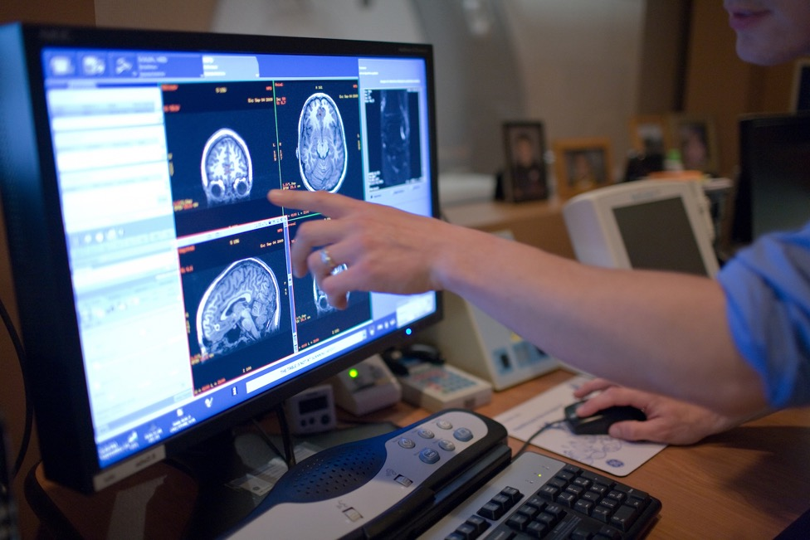
What do I need to do to take good brain pictures?

Slide 14


When your family or friends take pictures, it is very important that you hold very still while the camera is running.
If you don’t hold still, the picture will be blurry.
We want you to hold still so that your pictures turn out very, very clear.
We can’t see Lightning McQueen because he is moving too much ☹
Yay! Now we can see Lightning McQueen because he is holding still!

Slide 15
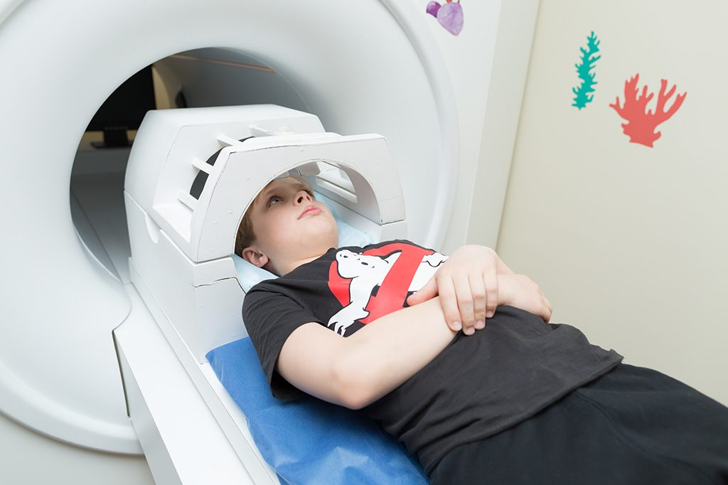

The “Statue Game”
To remember to hold very still, I like to play The Statue Game because statues hold very, very still.
Can you show me what type of statue you want to be?

Slide 16
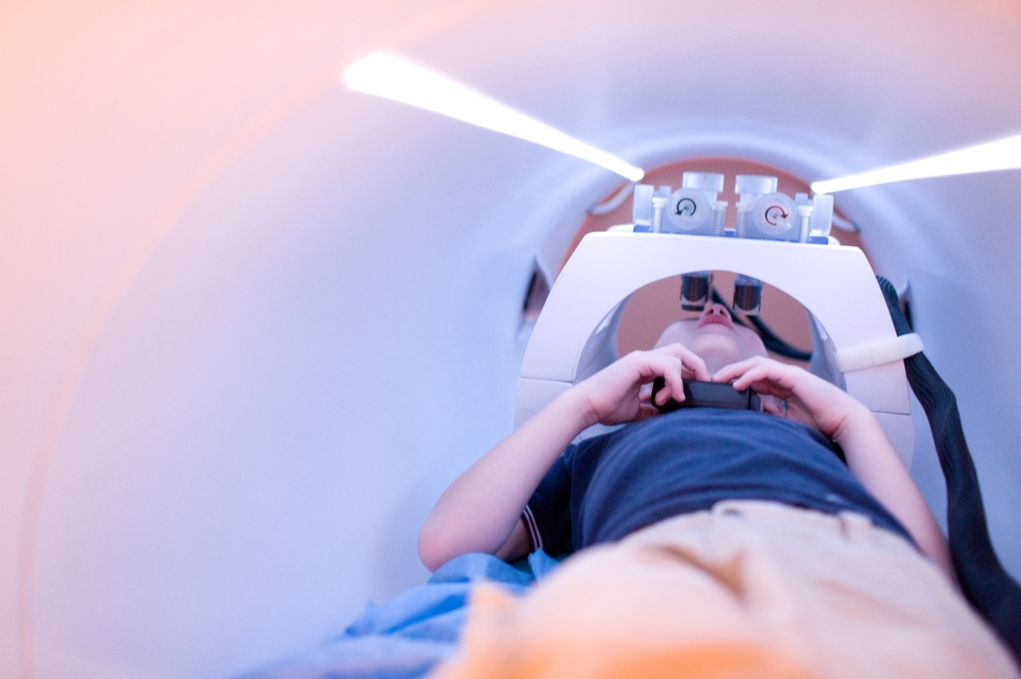
How do I get my brain pictures taken?

Slide 17
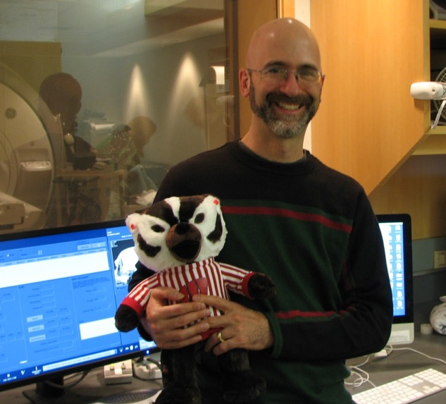
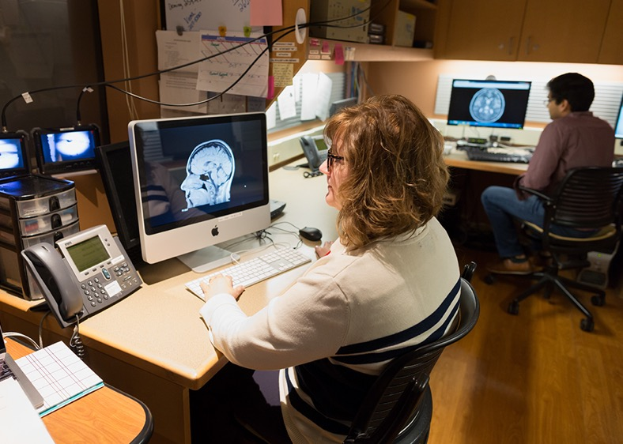
You will meet a friendly person who takes the MRI brain pictures and who will help you know what to do.

Slide 18
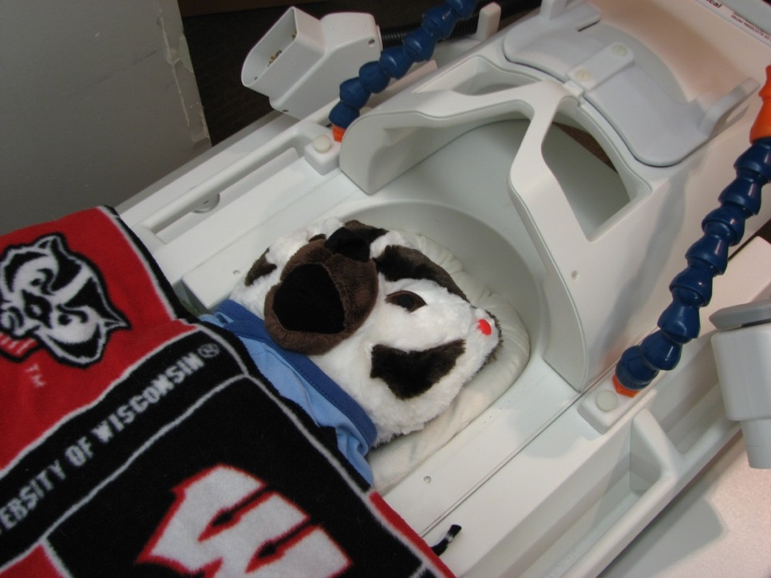
Now that you’re all ready to watch your movie, it’s time to lay down on the brain camera table. This table is soft like your bed at home.

Slide 19
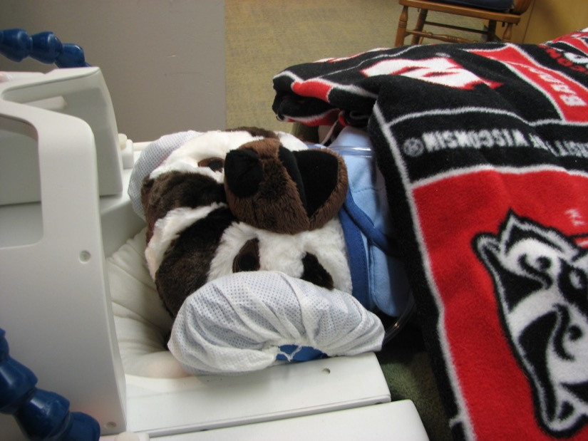
To further block out the loud MRI noises, we will place headphones around your head.
Headphones to further block out sound

Slide 20
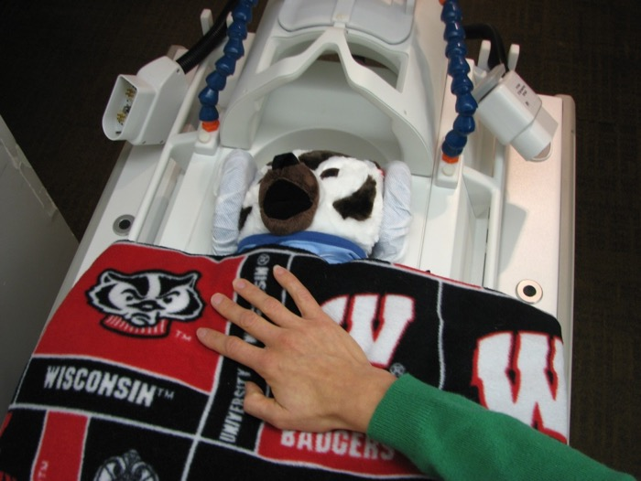
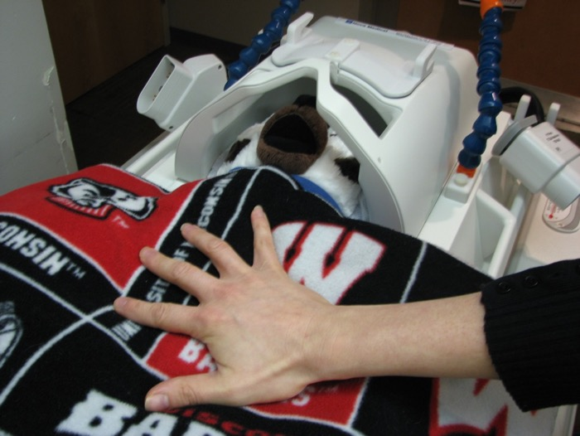
When you are comfortable, we will slide the head coil over your head. The head coil is like an astronaut helmet that helps the MRI machine take brain pictures.
Head coil “helmet” off
Head coil “helmet” on

Slide 21
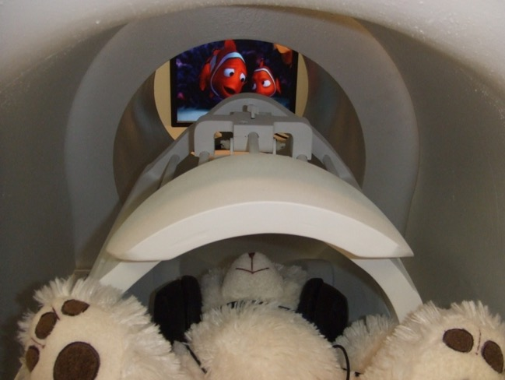
Once the head coil helmet is on, we will show you the special mirror that will help you watch the movie. The mirror is on the top part of our helmet.
Here, you can see Bucky’s friend, Mr. Bear, watching Finding Nemo. See the fish in the background? That’s the movie playing so he can watch it!

Slide 22

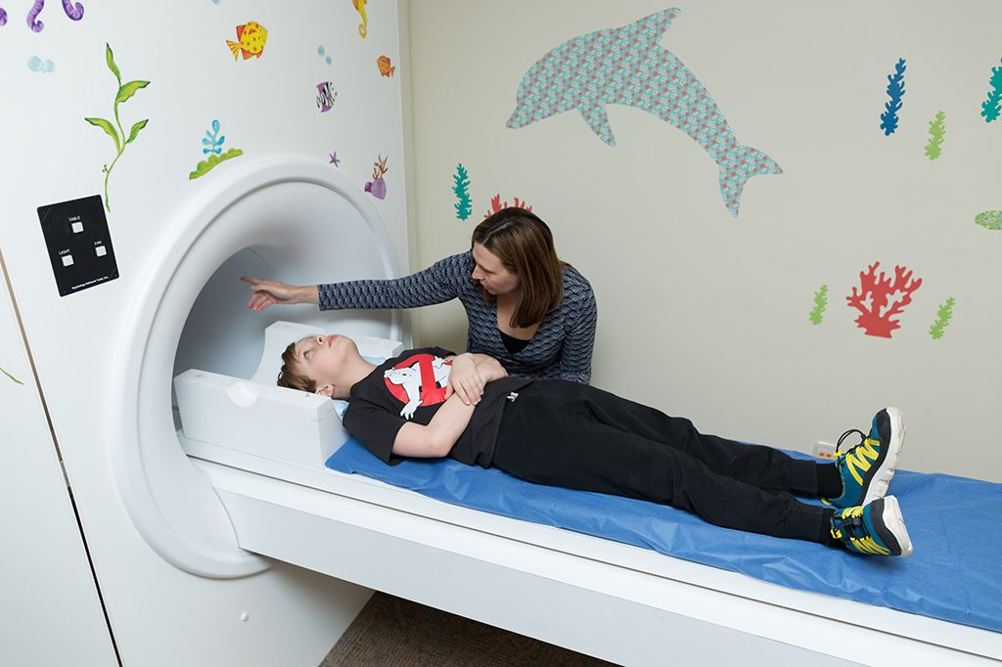
Just like a train drives into a tunnel, the table will move a little way into a short tunnel-like area. This is where the camera will take the photos of your brain while you watch the movie.

Slide 23
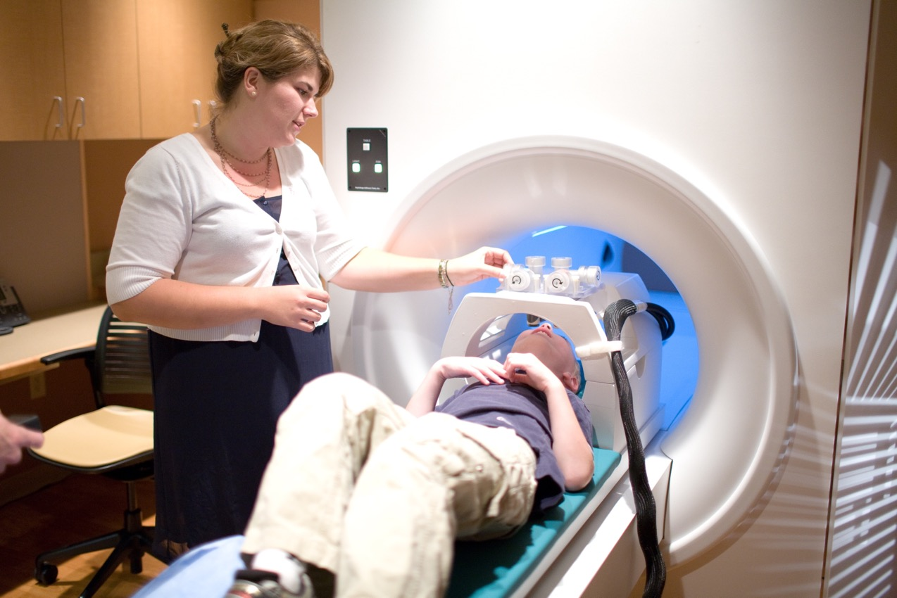
Your parents will be nearby, and the research team will be with you the entire time.

Slide 24
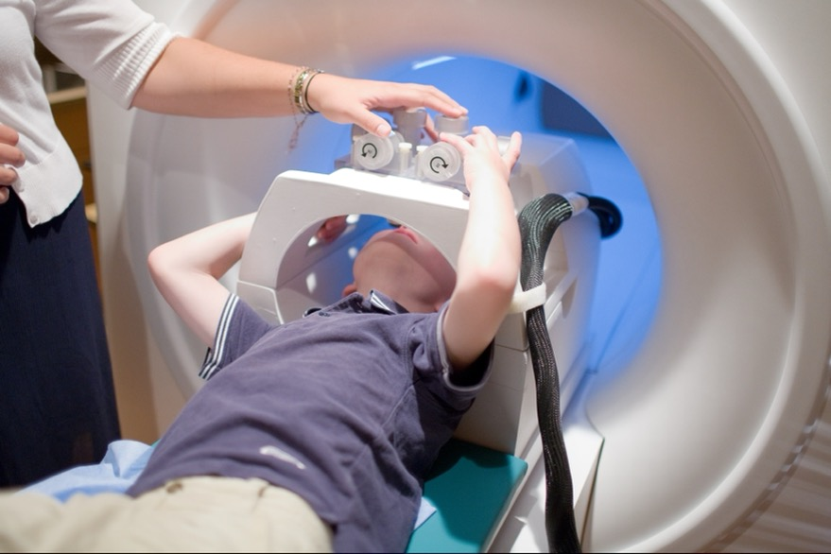
Will people know I was in this study?
You can tell people you helped in this study, but we will not tell people.

Slide 25
During this research, there is a risk that…
You may become tired or frustrated. We can always take a break!
Going into the MRI brain camera can sometimes feel scary. We will take our time and give you lots of practice!
When doing tasks where you need to move your body, you might lose balance. We will be there to catch you if you fall!

Slide 26
It is your choice.
It is your choice to be in this research. You can decide not to be in this research, and no one will be mad at you. Also, you can change your mind. If you start the study, you can still stop at any point.

Slide 27

Any other questions?
We are happy to answer them for you!

